Slide 1

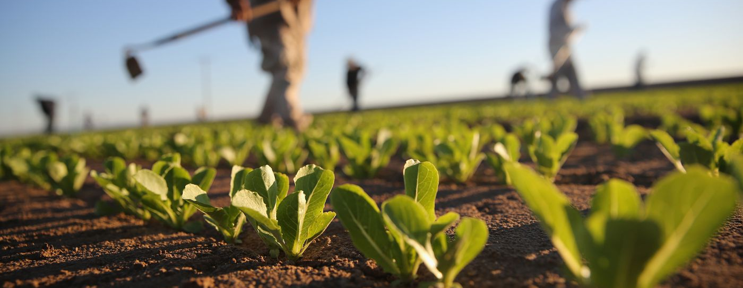


Food and Feed: Friend or Foe to the Environment?

Slide 2
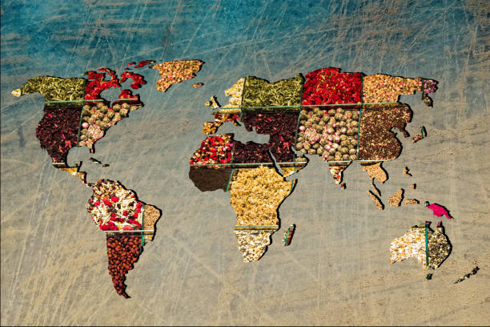
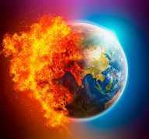
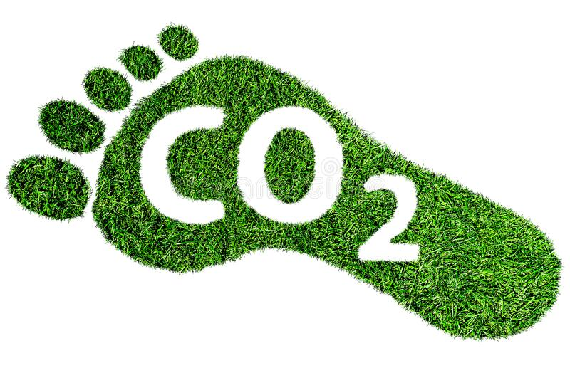
Introduction
Over the past few centuries, the world population has increased exponentially, and it is projected to reach 10 billion by 2050. With this growth, there has been an increased demand for food, energy, and water. However, this has also resulted in several crises, including the pressing issue of climate change.
One major contributor to climate change is the agricultural and livestock sector, which accounts for 25-30% of global CO emissions. As we seek to address the challenges of meeting the world's growing needs, it is important to consider the impact that these sectors have on the environment and work towards finding sustainable solutions.

Slide 3
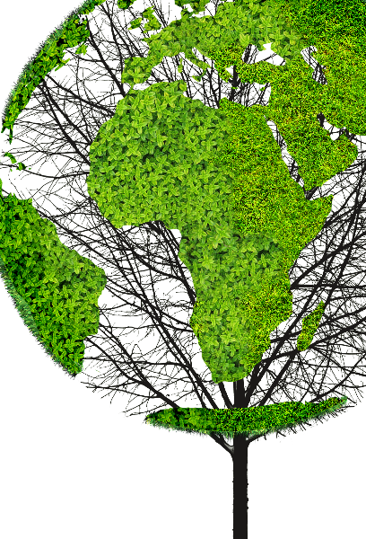
Objective
Investigating Global Food and Feed Production and its Co2 footprint.
The objective of this report is to investigate the global production of food and feed and the associated environmental challenges such as climate change and pollution. We will use various datasets to provide an overview of crops, livestock, and fisheries production, as well as examine the primary pollutants related to these activities. The findings will assist stakeholders in identifying key challenges and developing sustainable solutions to meet the world's growing demand for food and energy while minimizing environmental impact.

Slide 4
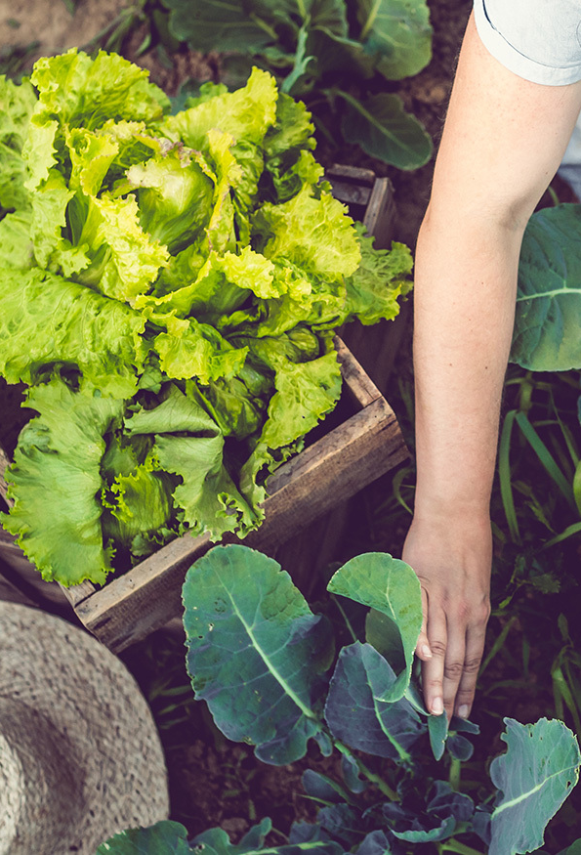
MAIN FOCUS
3 topics related to Global Food Production and its Environmental Impact
Feeding the World: An In-Depth Look at Global Food and Feed Production. Global Food and Feed production comparison
Uncovering the Carbon Footprint of Food: The Environmental Impact of Production Emissions. CO₂ emissions from food production
Heating Up: Exploring the Impact of Climate Change on Temperature Trends Worldwide. Climate Change -Temperature Changes

Slide 5
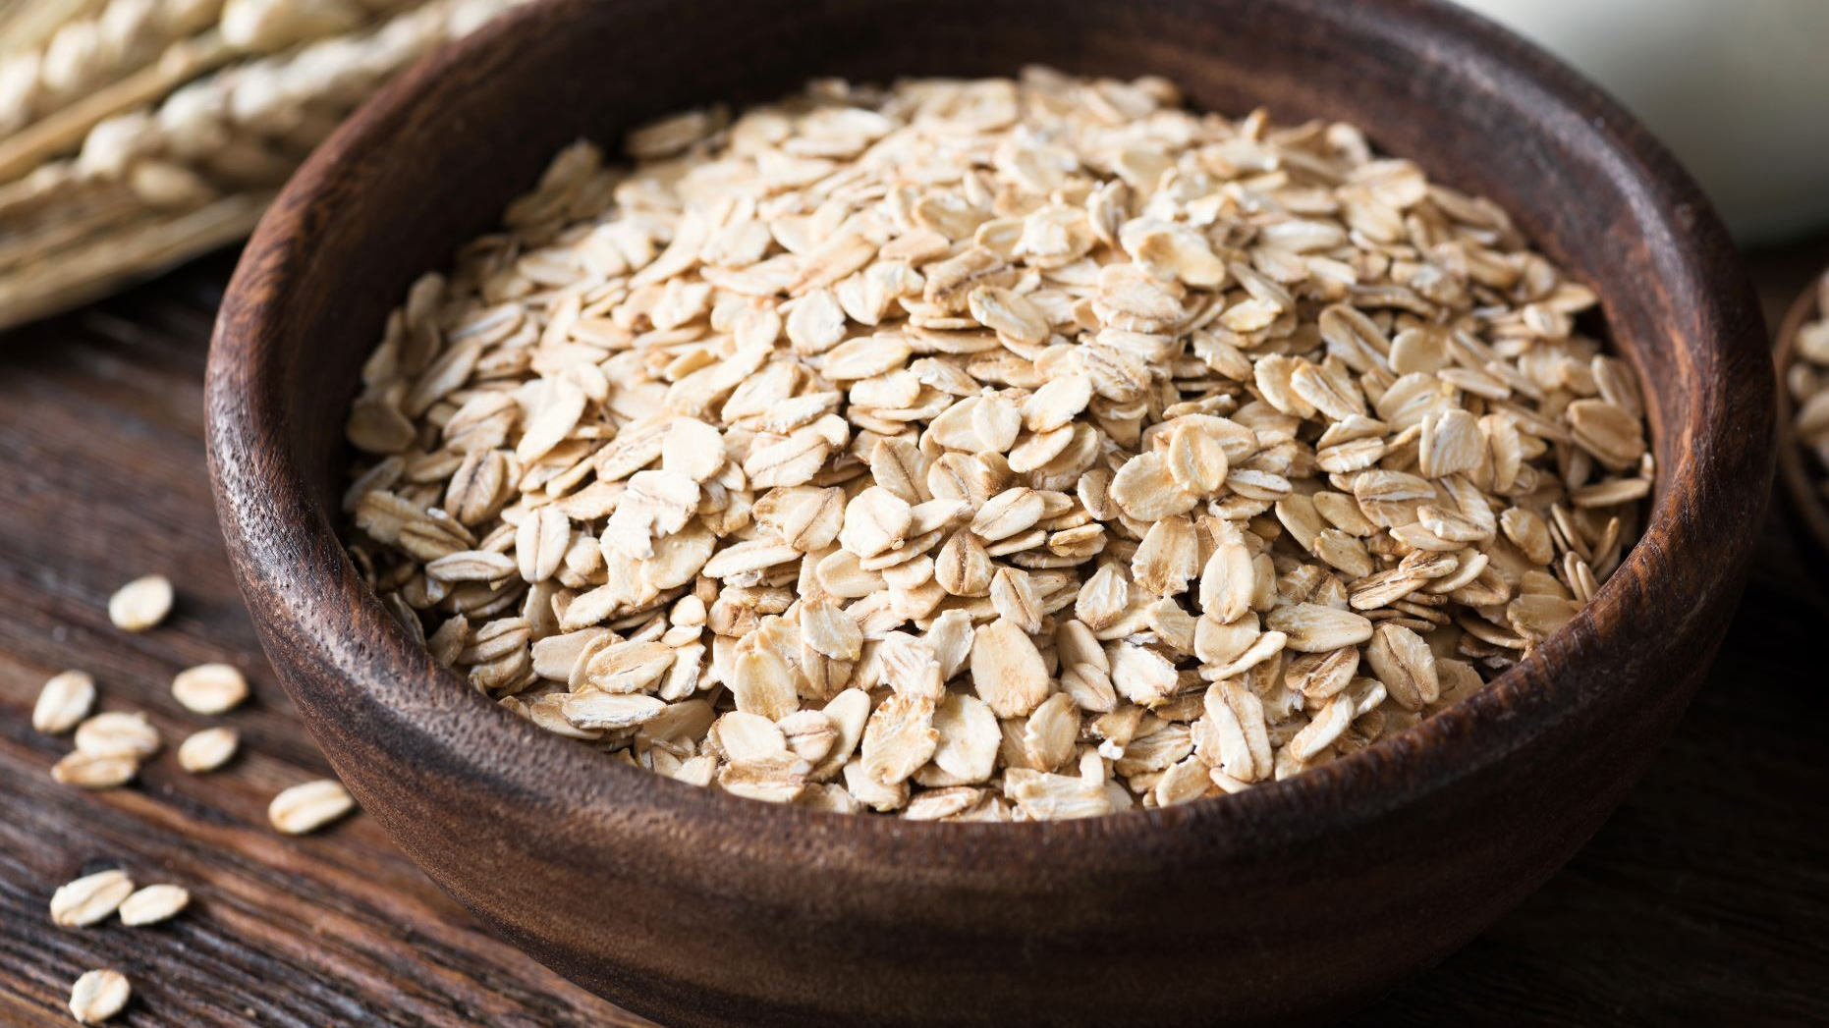
Global Food and Feed Production Comparison
Food is any substance that humans consume for nutrition, sustenance, or pleasure. This can include fruits, vegetables, grains, meat, dairy products, and processed foods.
Feed refers to substances given to livestock or poultry to provide them with the necessary nutrients for growth, health, and productivity. Animal feed can include a variety of ingredients, such as grains, protein sources, minerals, and vitamins, and is formulated to meet specific nutritional requirements for different animal species and stages of growth.

Slide 6
Questions Addressed
What changes have occurred in the production of food and feed over the years, according to the available data?
Which countries have been the biggest contributors to global food and feed production?
What are the most commonly produced food and feed items on a global level, based on the available production data?

Slide 7
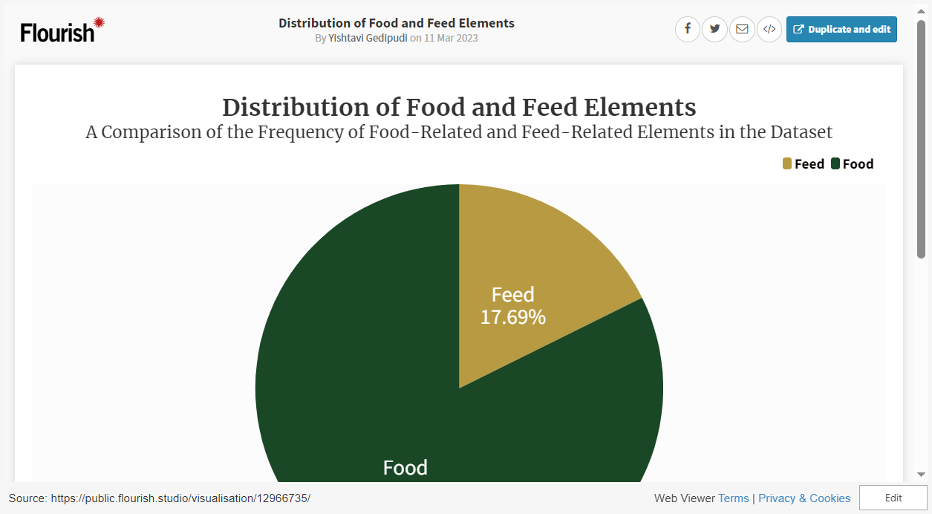
Distribution of Food and Feed Elements

Slide 8
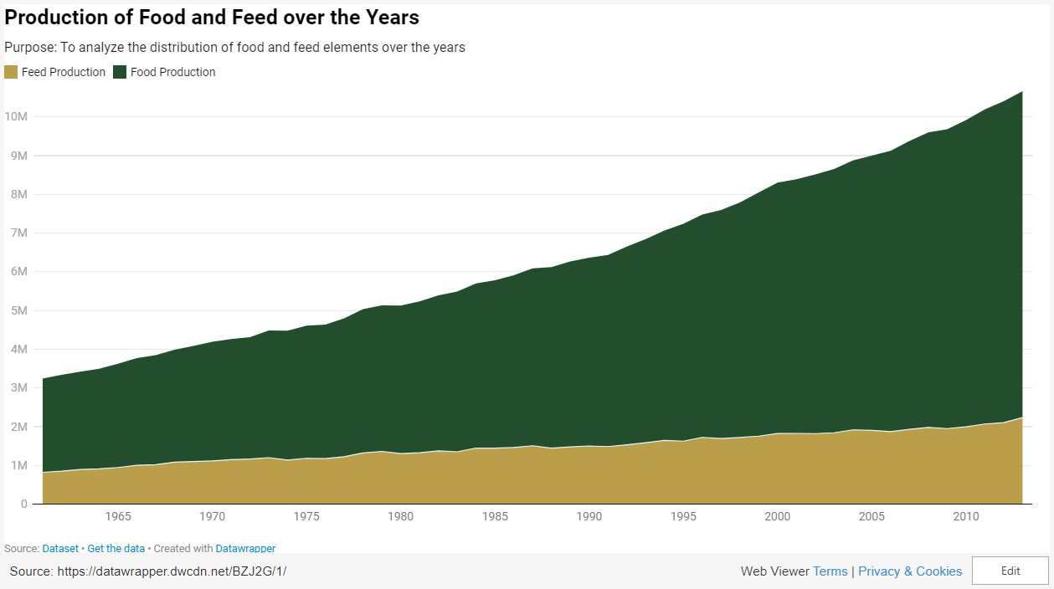
Production of food and feed over the years

Slide 9
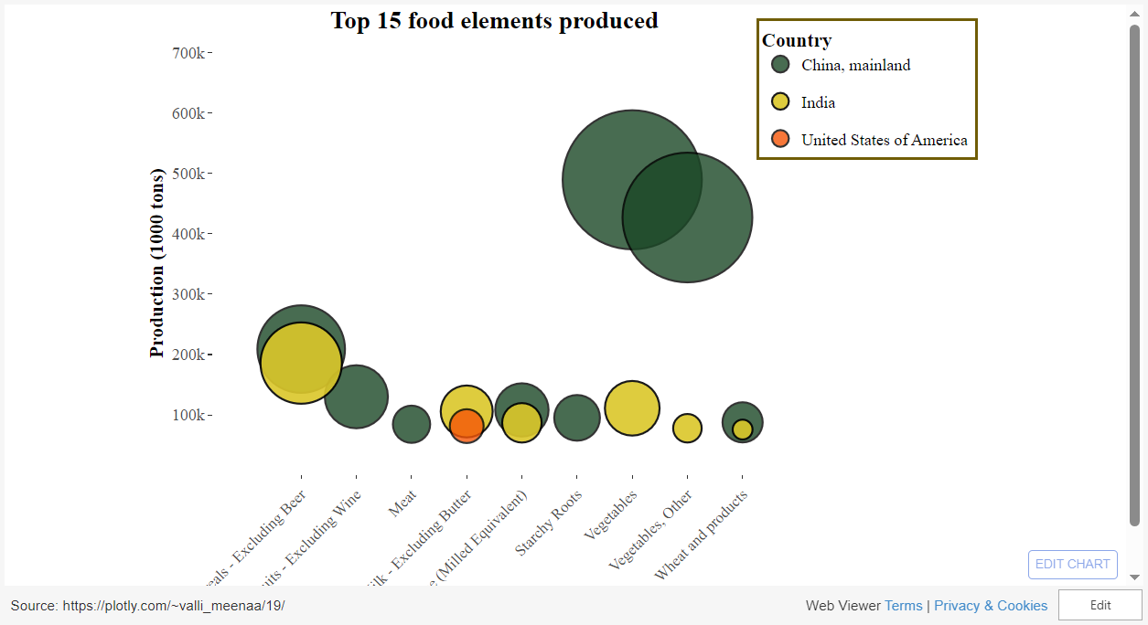
Top 15 food elements with the highest production values and which countries produced them

Slide 10
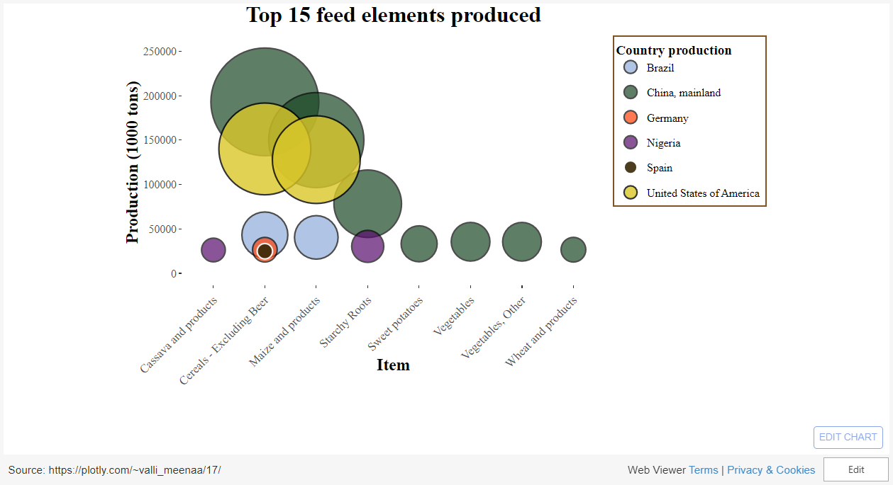
Top 15 feed elements with the highest production values and which countries produced them

Slide 11
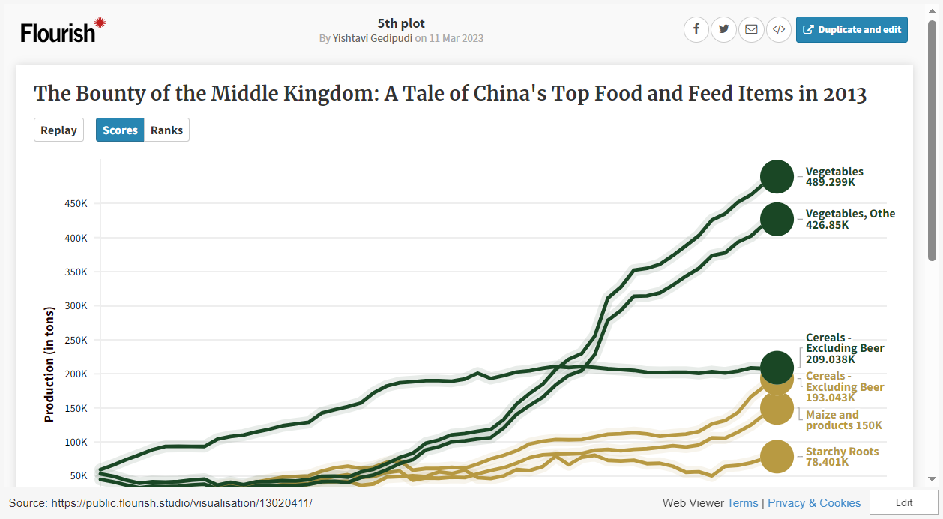
The Bounty of the Middle Kingdom: A Tale of China's Top Food and Feed Items in 2013

Slide 12
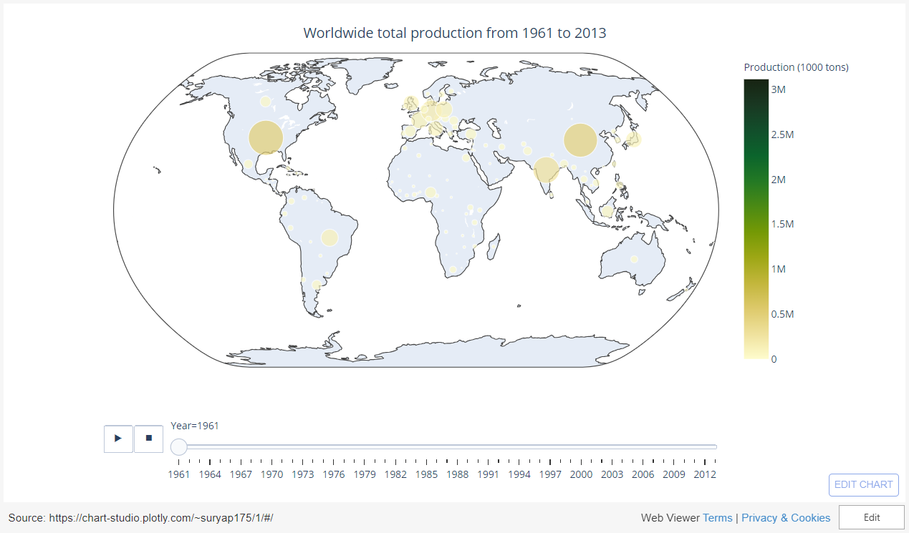
Worldwide Total Production over the years

Slide 13
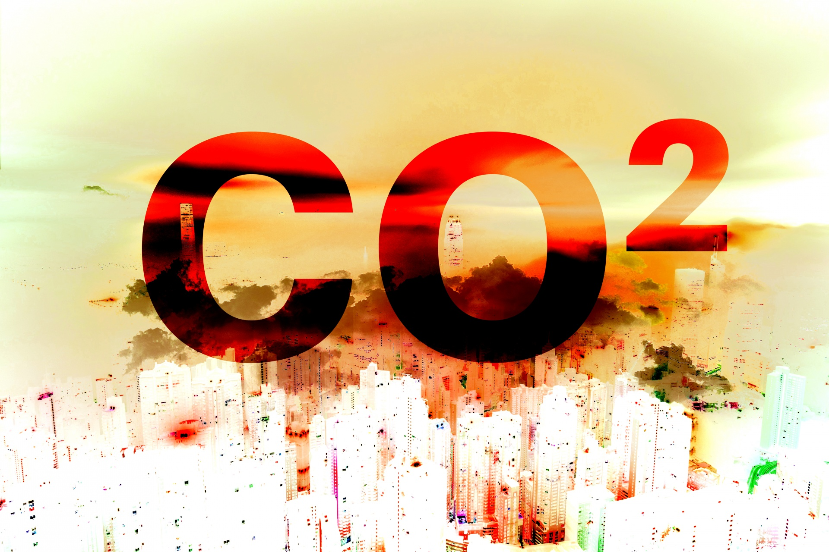
2. Uncovering the Carbon Footprint of Food: The Environmental Impact of Production of Emissions
CO₂ emissions from food production
Different foods have different carbon footprints, depending on how they are produced, transported, and consumed. Beef and lamb have the highest carbon footprints among commonly consumed foods, while chicken, rice, and wheat have lower carbon footprints. Choosing more sustainable options and reducing food waste can help reduce the carbon footprint of our food.

Slide 14
Questions Addressed
What is the breakdown of the distribution of elements that contribute to total CO₂ emissions from food production?
What are the 8 foods with the highest total CO₂ emissions in terms of food production?
Could you share the top 8 food items that have the highest total CO₂ emissions when considering all production steps
Which 10 food items have the highest land usage when it comes to food production?

Slide 15
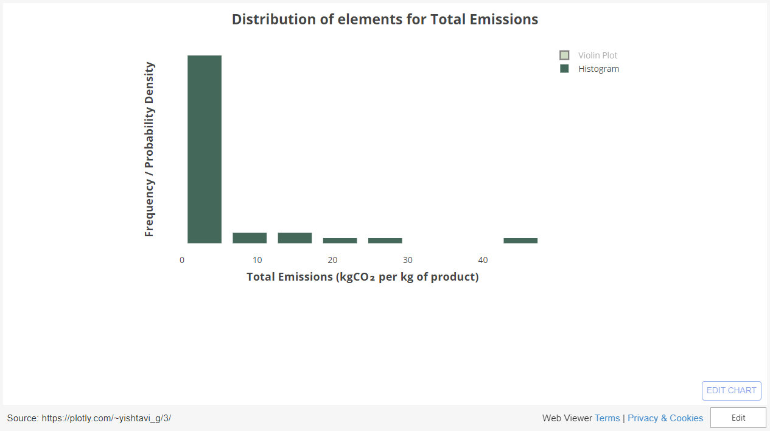
Distribution of elements that contribute to total CO₂ emissions

Slide 16
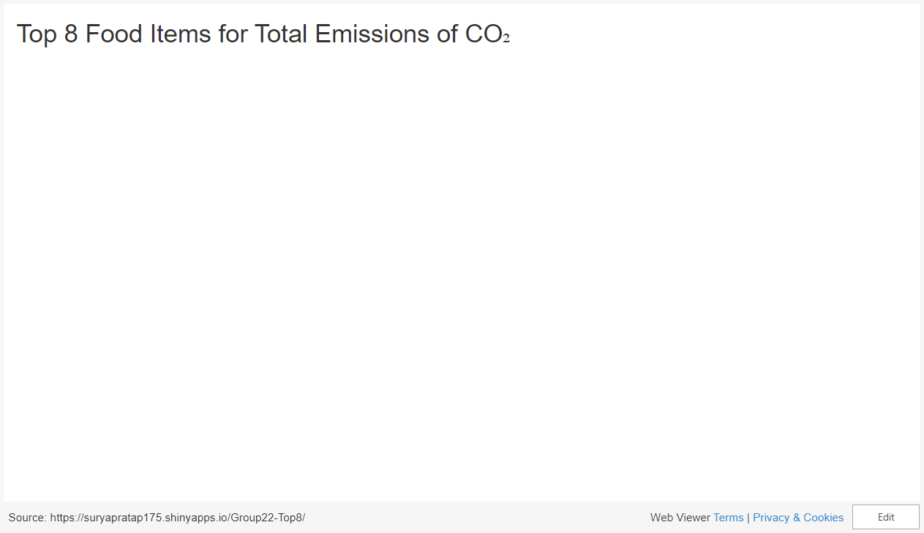
8 foods with the highest total CO₂ emissions

Slide 17
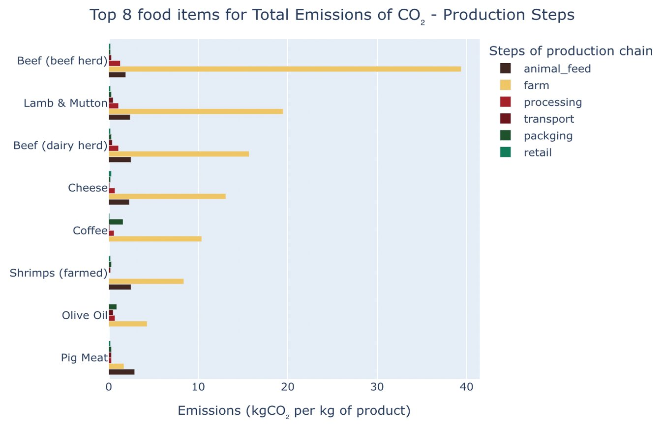
Top 8 food items that have the highest total CO₂ emissions when considering all production steps

Slide 18
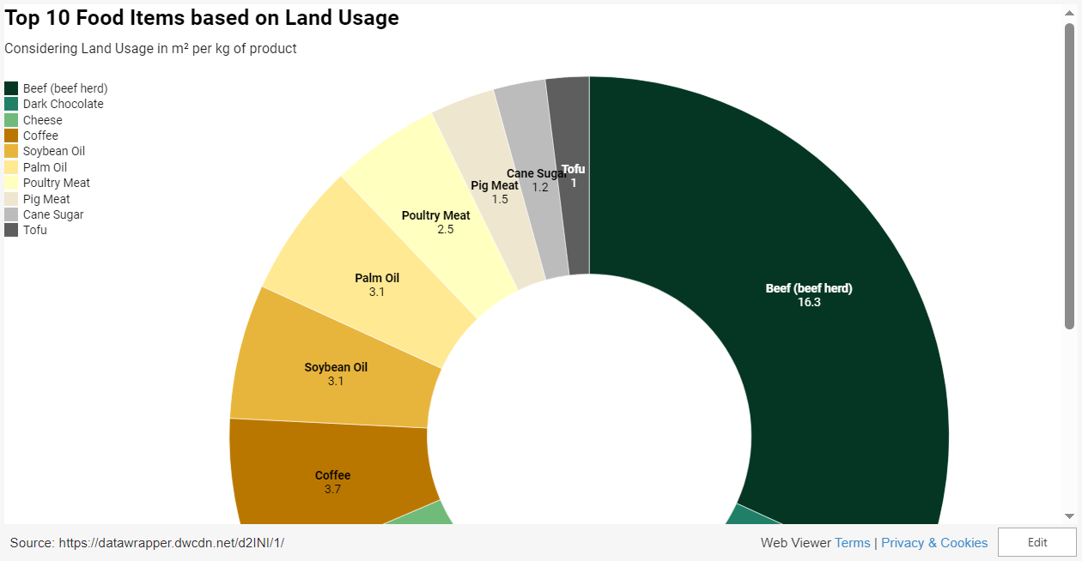
10 food items that have the highest land usage when it comes to food production

Slide 19
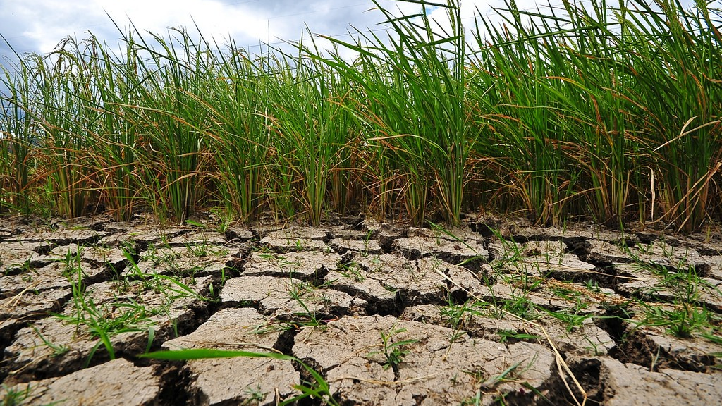
3. Heating Up: Exploring the Impact of Climate Change on Temperature Trends Worldwide
Climate Change - Temperature Changes
The temperature change dataset for the world provides options to analyze particular time periods such as seasons, months, or years, as well as specific factors like countries, continents, or the entire world. The questions that we'll be addressing in this section are as follows:
How do global climate changes differ from the seasonal changes of spring, summer, autumn, and winter?
How does global climate change vary throughout the 12 months of the year?
What has been the climate change trend for each country from 1961 to 2019?

Slide 20
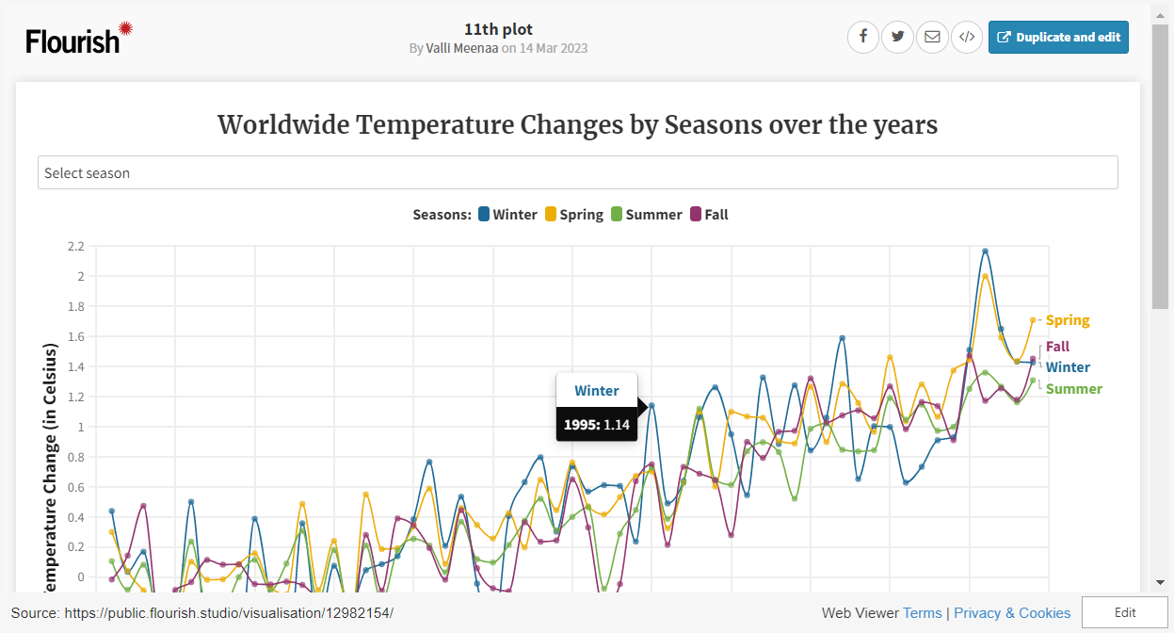
Global climatic changes differing based on four seasons: spring, summer, autumn, and winter

Slide 21
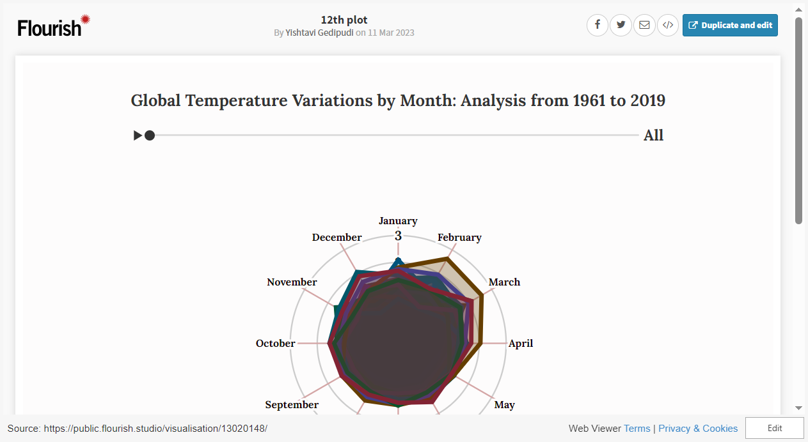
Global climate change varying throughout the 12 months of the year

Slide 22
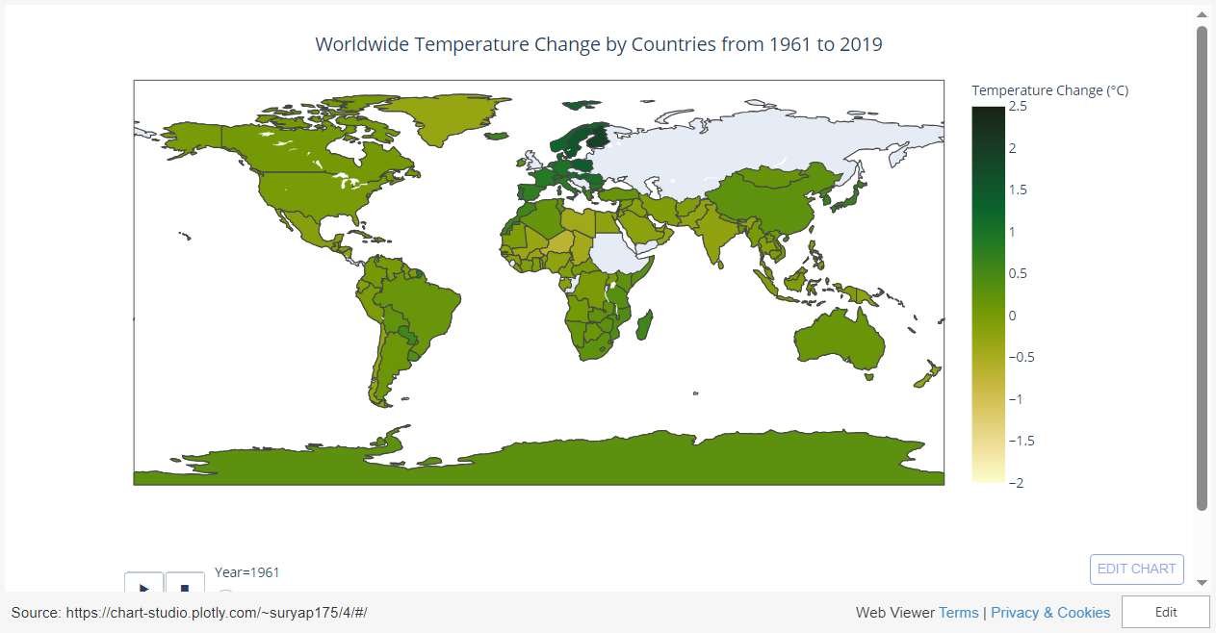
The climate change trend for each country from 1961 to 2019

Slide 23
Conclusion
In the past few decades, there has been a significant increase in the global production of food and feed. A noteworthy finding from our analysis is that a small number of countries, such as China, India, and the United States of America, produce a vast quantity of food. Moreover, plant-based foods were found to be the most widely produced in 2013, which is a positive outcome considering the results obtained from the CO₂ emissions dataset.
The analysis revealed that the production of animal-based foods, such as beef, sheep, pig, cheese, and dairy products, emits a considerable amount of CO₂. Beef, in particular, is not only the most polluting food but also requires a significant amount of land use.
Furthermore, an analysis of the temperature change dataset indicates that the Earth's temperature has risen considerably over the past four decades. This phenomenon affects the entire planet rather than a specific season or region.
These findings should prompt us to contemplate what we eat, how we produce it, and how we can minimize the impact on the environment.

Slide 24

THANK YOU :) GROUP 22 - Valli Meenaa Vellaiyan -Yishtavi Gedipudi - Surya Pratap Singh
z

